Slide 1
CSE470: Software Engineering
Software Architecture

Slide 2

What is Software Architecture
Architectural design is concerned with understanding how a software system should be organized and designing the overall structure of that system.
Software Architecture is how the defining components of a software system are organized and assembled. How they communicate each other. And how the constraints of the whole system is ruled by.
The architectural model serves as a input to the development phase.

Slide 3
Advantages of explicit architecture
Stakeholder communication
Architecture may be used as a focus of discussion by system stakeholders.
System analysis
Means that analysis of whether the system can meet its non-functional requirements is possible.
Large-scale reuse
The architecture may be reusable across a range of systems
Product-line architectures may be developed. (Softwares with common features like e-commerce)

Slide 4
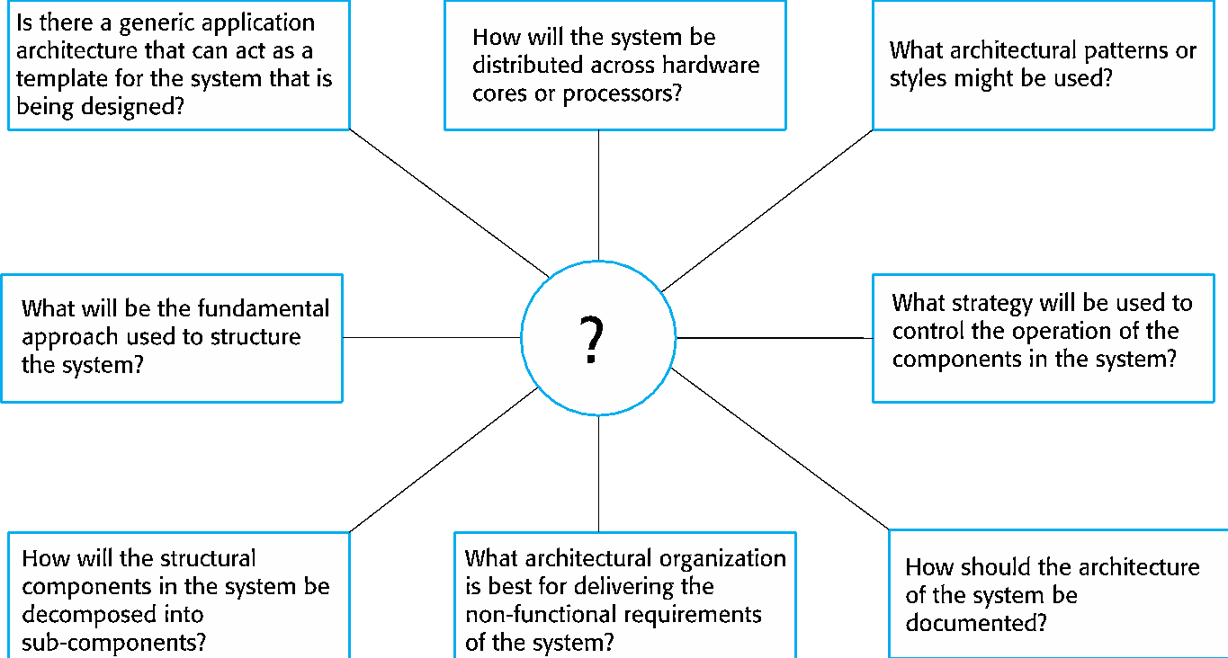
Architecture Design Decisions

Slide 5
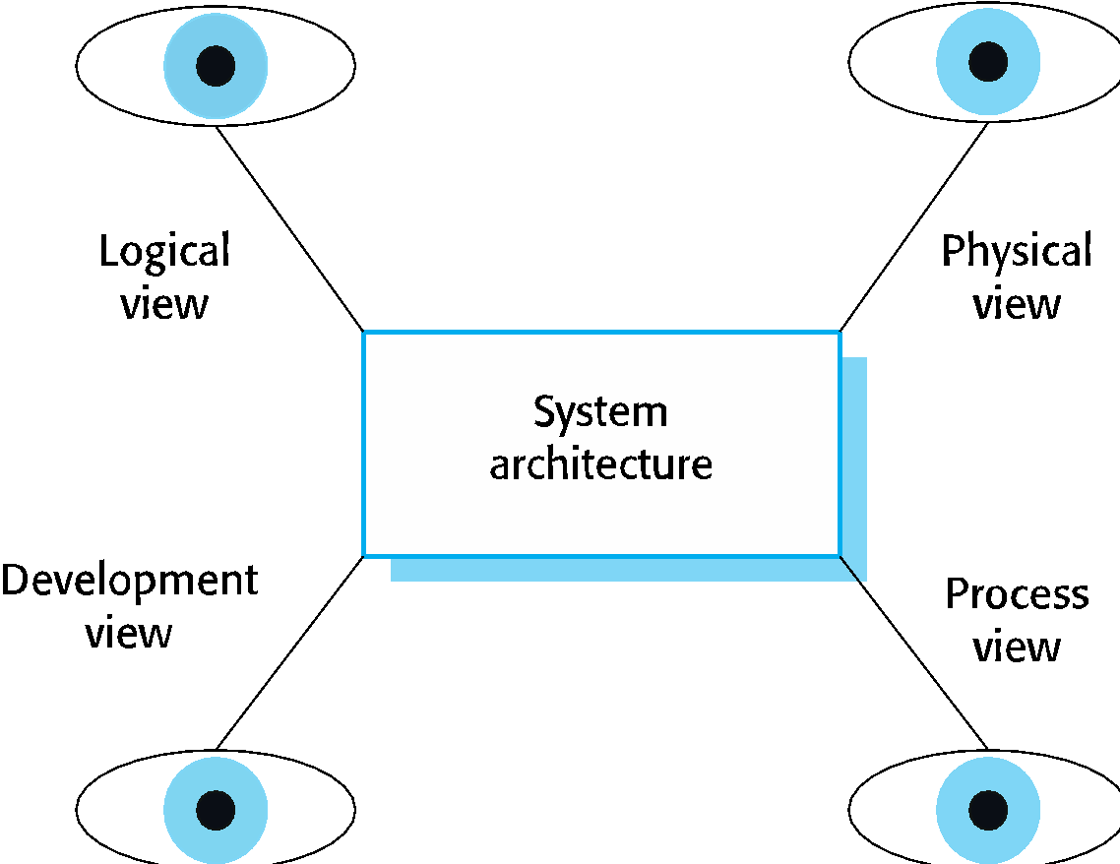
Architectural View
There are four views from which the architecture of a software can be observed
Each architectural diagram only shows one view or perspective of the system.

